Slide 1
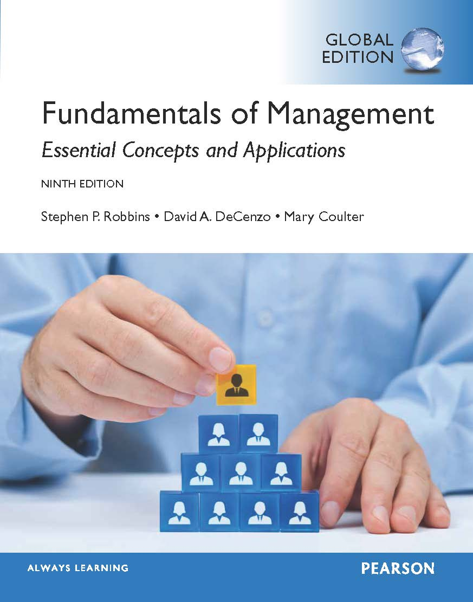
14
Chapter
Foundations
of Control
© Pearson Education Limited 2015
14-<number>

Slide 2
Learning Outcomes
Explain the nature and importance of control.
Describe the three steps in the control process.
Discuss the types of controls organizations and managers use.
Discuss contemporary issues in control.
© Pearson Education Limited 2015
14-<number>

Slide 3
14.1
Explain the nature and importance of control.
© Pearson Education Limited 2015
14-<number>

Slide 4
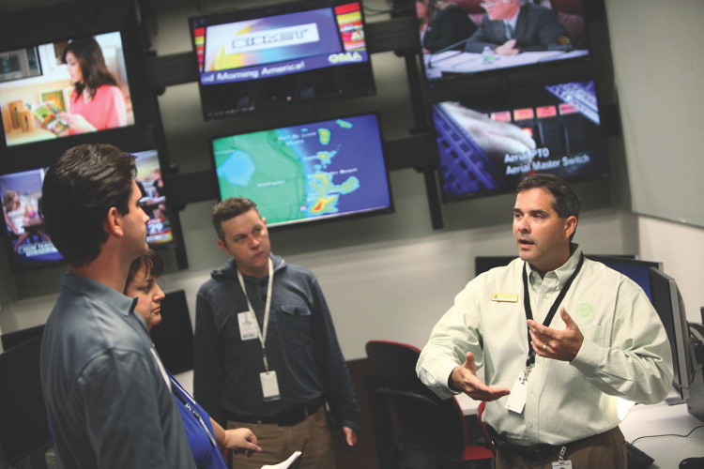
The Communication Process
© Pearson Education Limited 2015
14-<number>

Slide 5
Control is the management function that involves monitoring activities to ensure that they’re being accomplished as planned and correcting any significant deviations.
© Pearson Education Limited 2015
1-<number>

Slide 6
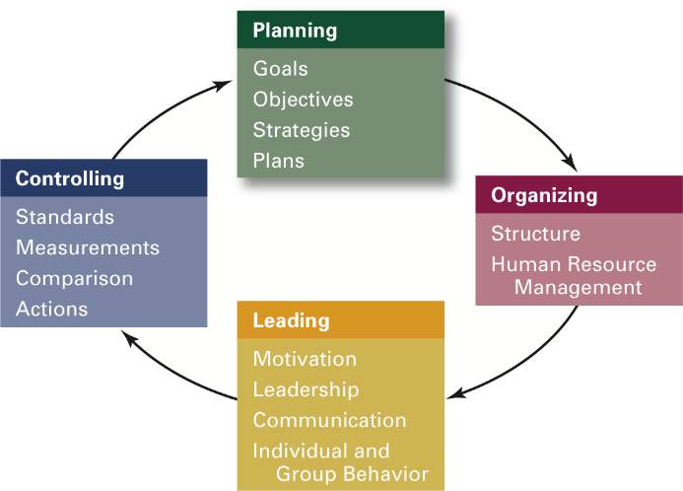
The Importance of Control
© Pearson Education Limited 2015
14-<number>

Slide 7
The value of the control function can be seen in three specific areas: planning, empowering employees, and protecting the workplace.
As the final step in the management process, controlling provides a critical link to planning.
  If managers didn’t control, they’d have no way of knowing whether their goals and plans were being achieved and what future actions to take.
© Pearson Education Limited 2015
1-<number>

Slide 8
The second reason controlling is important is because it can empower employees.
Many managers are reluctant to empower their employees because they fear that something will go wrong and they will be held accountable.
However, an effective control system provides information and feedback on employee performance and minimizes the chance of problems.
© Pearson Education Limited 2015
1-<number>

Slide 9
The final reason that managers control is to protect the organization and its assets.
Organizations face threats from natural disasters, financial pressures and scandals, workplace violence, supply chain disruptions, security, and even possible terrorist attacks.
Comprehensive controls and backup plans help minimize such work disruptions.
© Pearson Education Limited 2015
1-<number>

Slide 10
14.2
Describe the three steps in the control process.
© Pearson Education Limited 2015
14-<number>

Slide 11
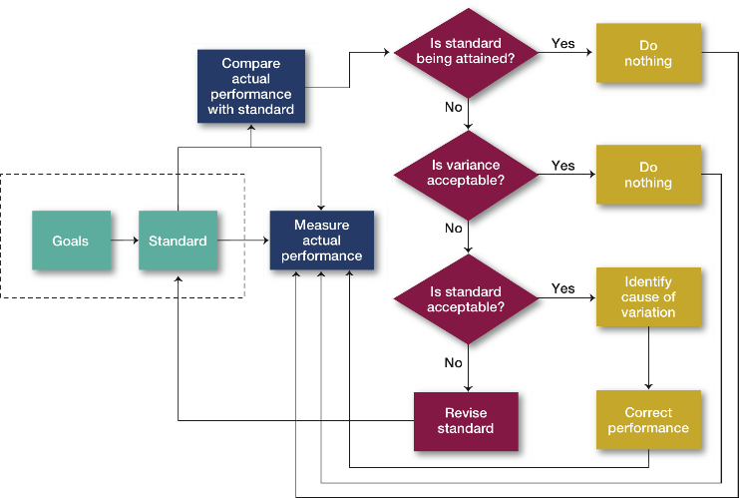
The Control Process
© Pearson Education Limited 2015
14-<number>

Slide 12
Measuring Performance
Sources of information:
  Personal observation
  Statistical reports
  Oral reports
  Written reports
© Pearson Education Limited 2015
14-<number>

Slide 13
Personal observation
  Management by walking around (MBWA) describes when a manager is out in the work area and interacting directly with employees, exchanging information about what’s going on.
  It’s an opportunity to observe body language.
  Personal observation, however, is subject to the viewer’s perceptual biases, is a time-consuming effort, and may trigger concern in some employees.
© Pearson Education Limited 2015
1-<number>

Slide 14
Statistical reports are not limited to computer outputs.
They can include graphs, bar charts, and numerical displays that managers can use for assessing performance.
© Pearson Education Limited 2015
1-<number>

Slide 15
Oral reports, which can be collected through conferences, meetings, one-to-one conversations, or telephone calls.
Although the information is filtered, it is fast, allows for feedback, and permits expression, tone of voice, and words themselves to convey meaning. It can also be recorded.
© Pearson Education Limited 2015
1-<number>

Slide 16
Written reports, which require more preparation time and formality than other measurements of performance.
This often makes them more comprehensive than oral reports.
© Pearson Education Limited 2015
1-<number>

Slide 17
Criteria for Measurement
What managers measure is probably more important to the control process than how they measure.
© Pearson Education Limited 2015
14-<number>

Slide 18
Selecting the right criteria to measure is critical for evaluating performance,
  but what we measure also influences the areas of work on which people in the organization will focus their efforts.
© Pearson Education Limited 2015
1-<number>

Slide 19
Some control criteria are applicable to any management situation.
  Because all managers direct the activities of others, criteria such as employee satisfaction or turnover and absenteeism rates can be measured.
  Keeping costs within budget is also a fairly common control measure.
© Pearson Education Limited 2015
1-<number>

Slide 20
Some activities are more difficult to measure in quantifiable terms.
  A manager to measure the performance of a medical researcher.
© Pearson Education Limited 2015
1-<number>

Slide 21
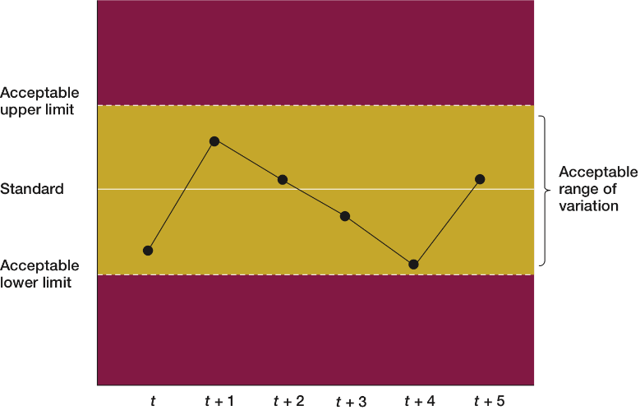
Range of Variation
© Pearson Education Limited 2015
14-<number>
Notes:
.

Slide 22
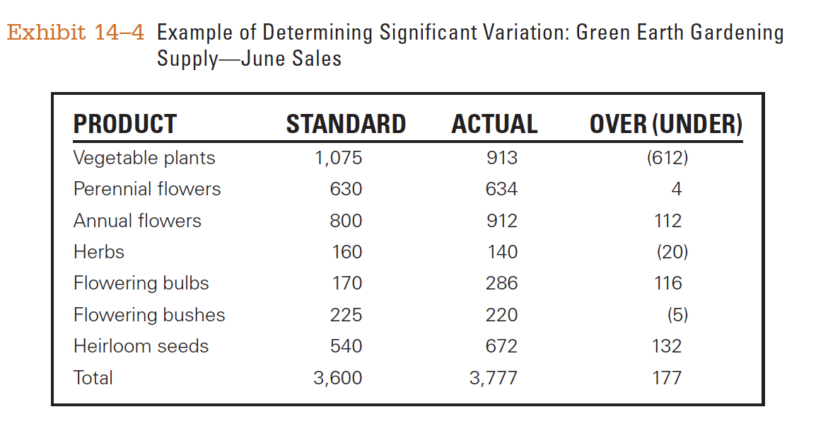
Comparing Performance to Goals
© Pearson Education Limited 2015
14-<number>

Slide 23
When faced with a decision, managers can choose among three courses of action:
  do nothing,
  correct the actual performance,
  revise the standards.
© Pearson Education Limited 2015
1-<number>

Slide 24
So how do you correct actual performance?
  Depending on the problem, a manager can take different corrective actions.
  For instance, if unsatisfactory work is the reason for performance variations, the manager could correct it with training programs, disciplinary action, changes in compensation practices
© Pearson Education Limited 2015
1-<number>

Slide 25
Revising Standards
If the variance results from an unrealistic standard—one that is set too low or too high—the standard, not the performance, needs corrective action.
For example: If performance consistently exceeds the goal, then the goal may need to be raised.
© Pearson Education Limited 2015
14-<number>

Slide 26
Correcting Performance
Immediate corrective action which corrects problems right away to get performance back on track
Basic correction action which looks at how and why performance deviated by correcting the source of deviation
© Pearson Education Limited 2015
14-<number>

Slide 27
14.3
Discuss the types of controls organizations and managers use.
© Pearson Education Limited 2015
14-<number>

Slide 28
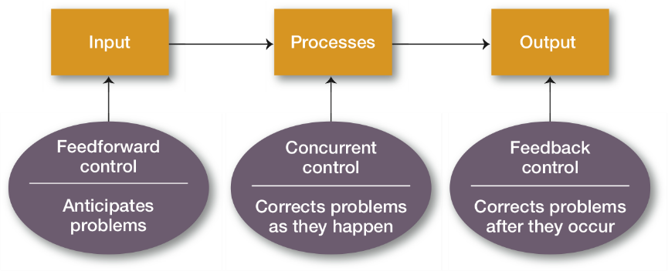
When does control take place?
© Pearson Education Limited 2015
14-<number>

Slide 29
Feedforward Control
The most desirable type of control—feedforward control—prevents problems because it takes place before the actual activity starts.
Ex: scheduled preventive maintenance programs on aircraft done by the major airlines.
© Pearson Education Limited 2015
1-<number>

Slide 30
Concurrent Control
Control that takes place while a work activity is in progress.
Ex: Google’s director of business product management and his team keep a watchful eye on one of its most profitable businesses—online ads.
© Pearson Education Limited 2015
14-<number>

Slide 31
Feedback Control
Control that takes place after a work activity is done.
© Pearson Education Limited 2015
14-<number>

Slide 32
This type of control has two advantages:
Feedback gives managers meaningful information on how effective their planning efforts were.
  1. Feedback that shows little variance between standard and actual performance indicates that the planning was generally on target.
  1.2. If the deviation is significant, that information can be used to formulate new plans.
Feedback enhances motivation because people want to know how well they’re doing.
© Pearson Education Limited 2015
1-<number>

Slide 33
14.4
Discuss contemporary issues in control.
© Pearson Education Limited 2015
14-<number>

Slide 34
Contemporary Issues
Cross-cultural differences
Workplace concerns
© Pearson Education Limited 2015
14-<number>

Slide 35
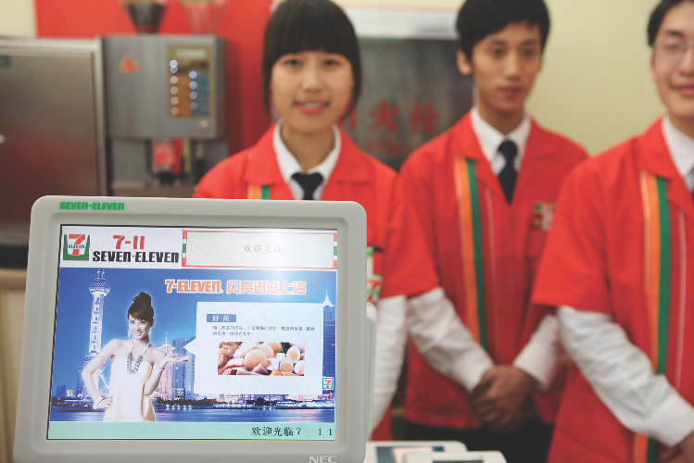
Cultural Differences
© Pearson Education Limited 2015
14-<number>

Slide 36
Organizations in technologically advanced nations use indirect control devices—particularly computer-based reports and analyses—in addition to standardized rules and direct supervision to ensure that activities are going as planned.
In less technologically advanced countries, direct supervision and highly centralized decision making are the basic means of control.
© Pearson Education Limited 2015
1-<number>

Slide 37
Managers in foreign countries may have constraints on what corrective action they can take because laws in some countries do not allow managers the option of closing facilities, laying off employees, or bringing in a new management team from outside the country.
© Pearson Education Limited 2015
1-<number>

Slide 38
Another challenge global companies face when collecting data is comparability. For instance, a company’s manufacturing facility in Mexico might produce the same products as a facility in Scotland, but the Mexican facility might be more labor intensive than its counterpart to take advantage of lower labor costs in Mexico. If top-level executives were to control costs by calculating labor costs per unit or output per worker, the figures would not be comparable.
© Pearson Education Limited 2015
1-<number>

Slide 39
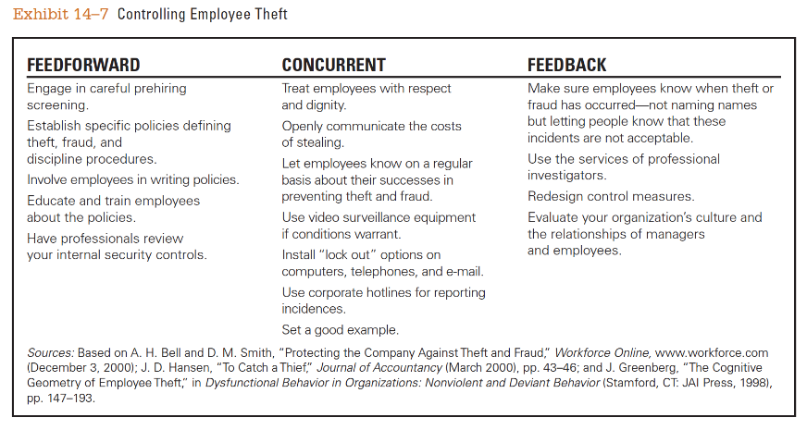
Controlling Employee Theft
© Pearson Education Limited 2015
14-<number>

